Slide 1
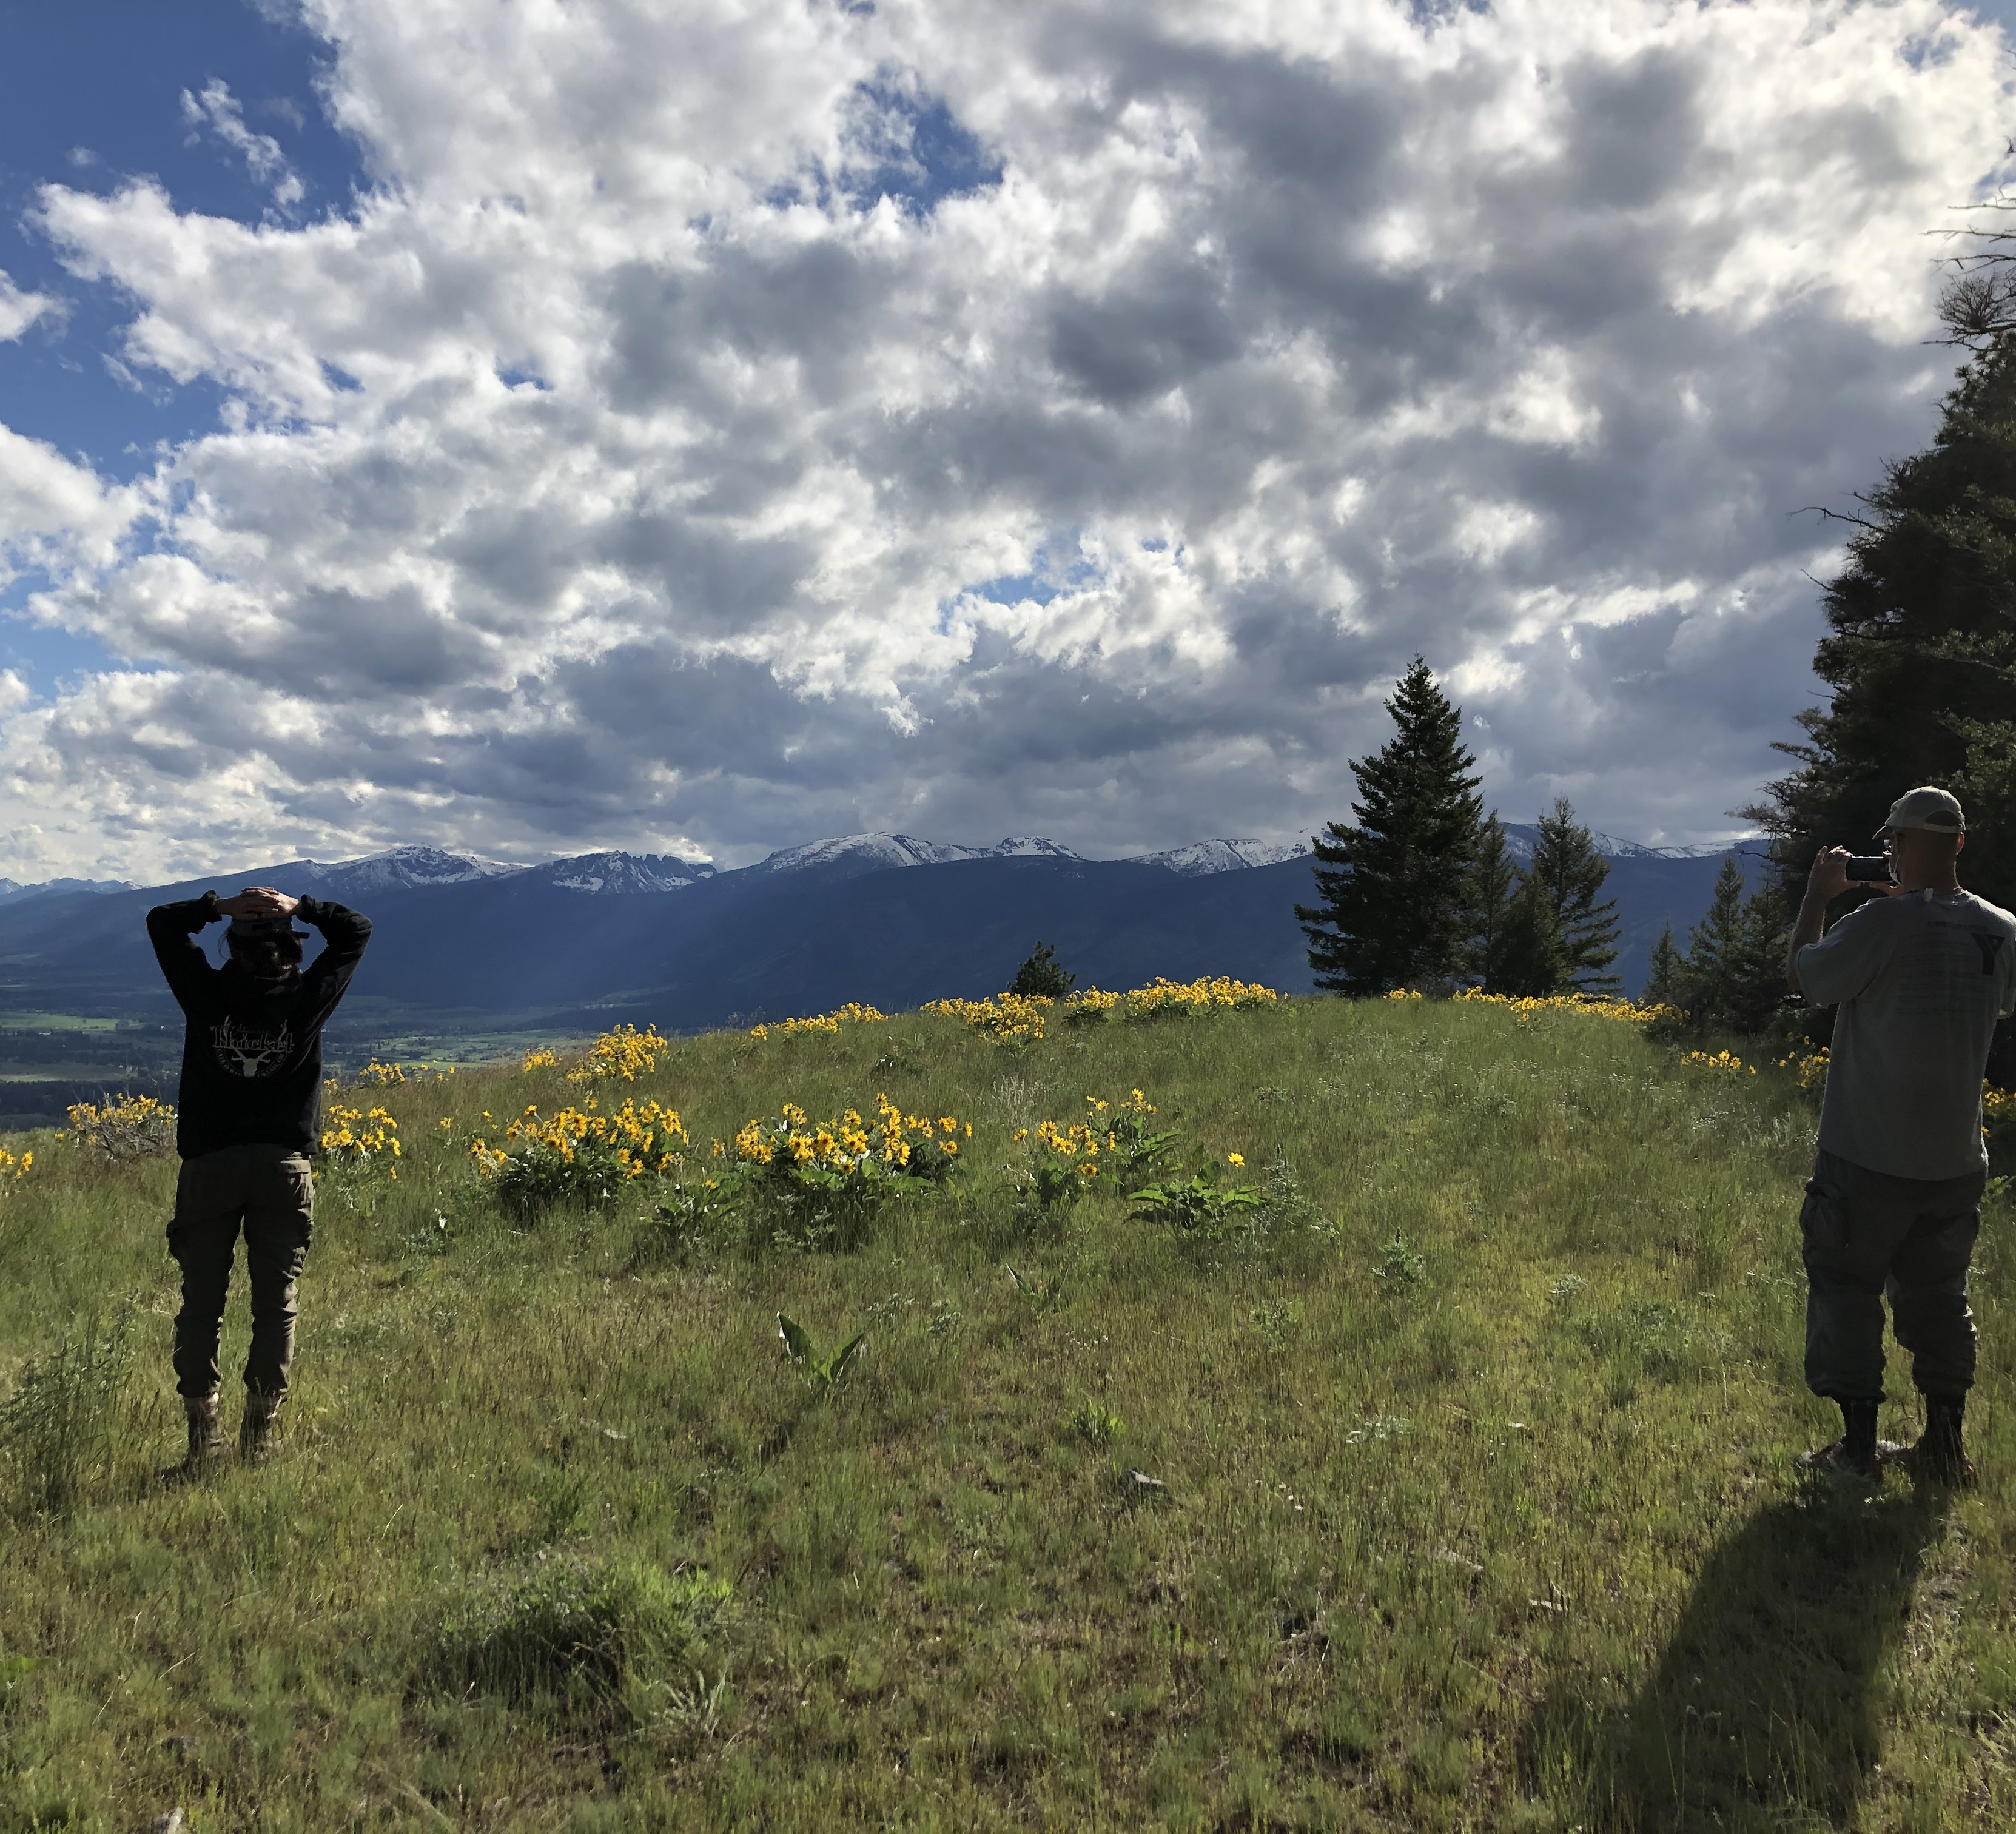




Multi-Species Fog Cultivation and Trait Measurements Of Biocrust to use for and inform restoration Recipes
Brianne Cooke
Arizona Space Grant Consortium
April 2022
Mentors
Jasmine Anenberg, PhD Student
Northern Arizona University
Dr. Anita Antoninka, Assistant Research Professor
Northern Arizona University

Slide 2
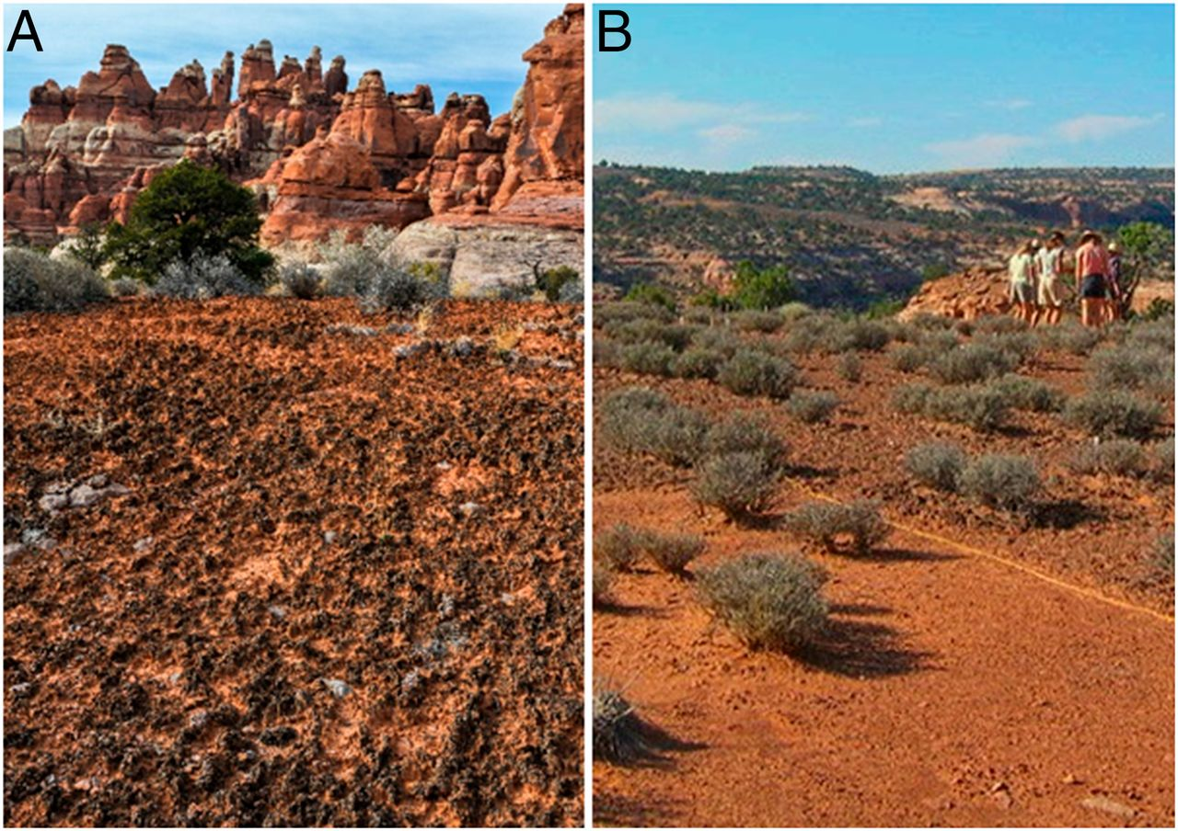
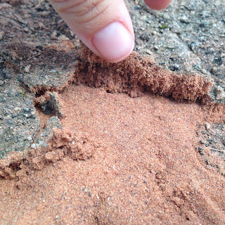

Background
Biocrust:
  A "skin" at the surface of soil
  Composed of cyanobacteria, lichens, mosses, liverworts
  Stabilizes soil against erosion, dust trapping, nutrient cycling, and influences ecosystem water balance
(Bowker, M., et al., 2018)
(Nature Conservancy, 2020)
(Antoninka, A., Bowker, M., 2015)

Slide 3
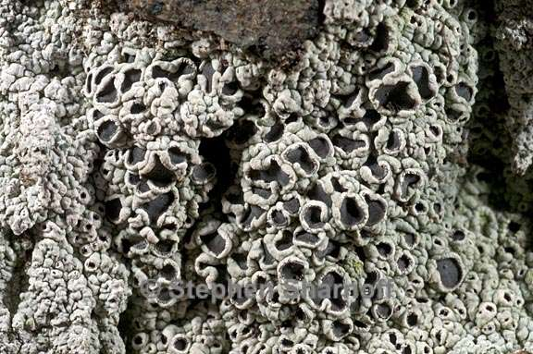
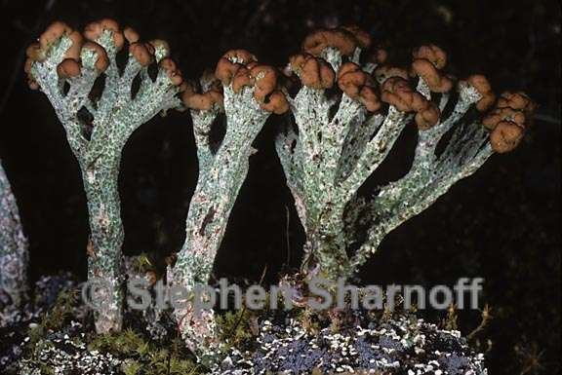
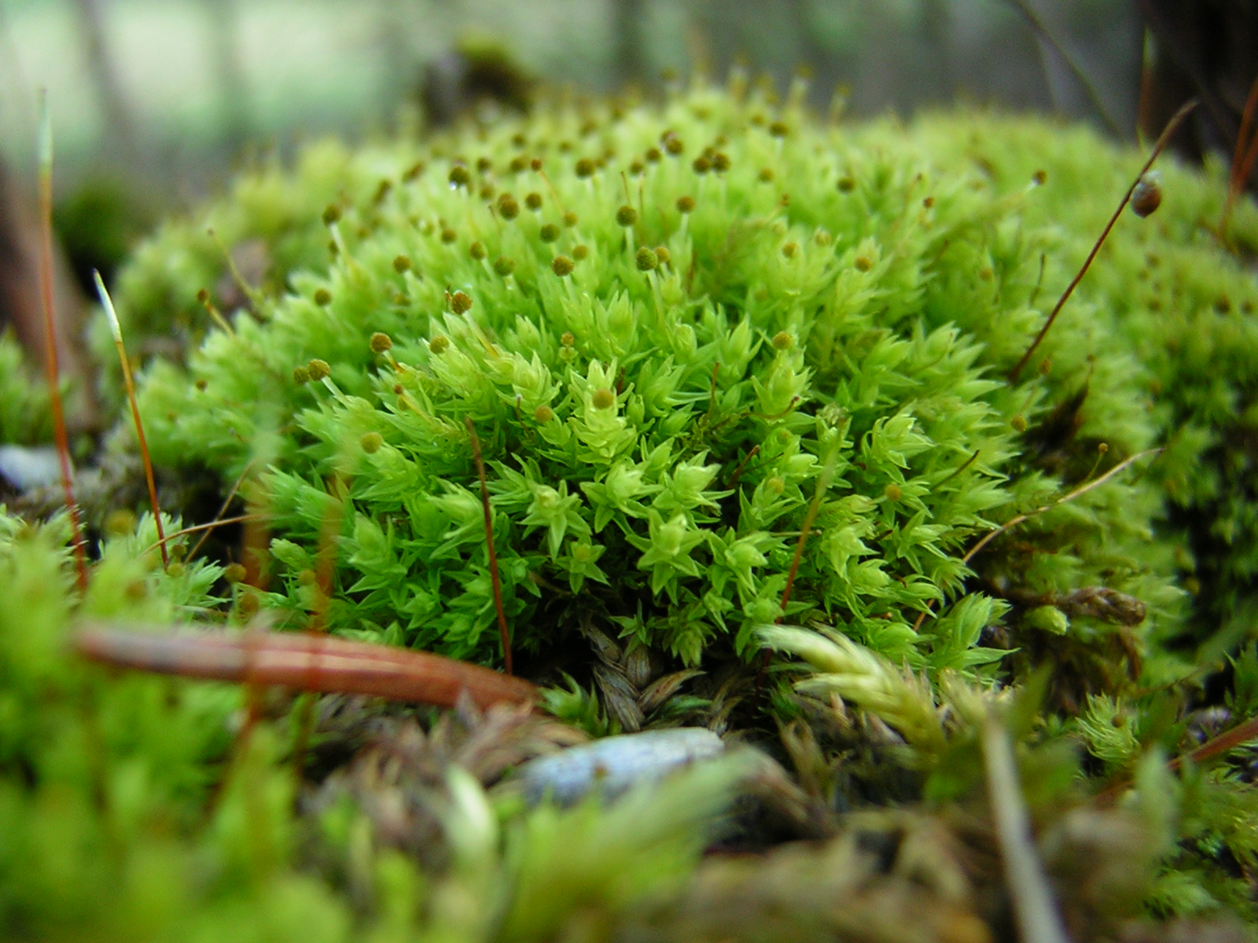
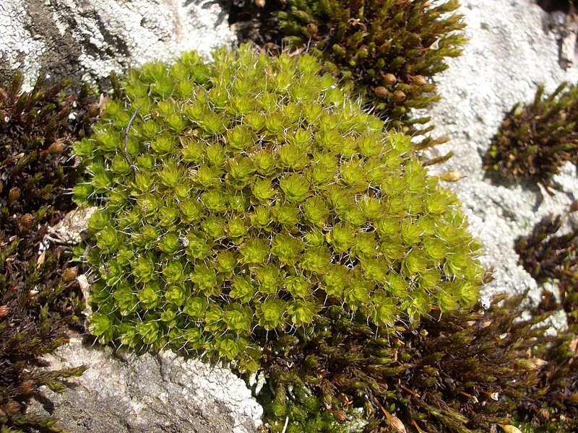
Photo Credits: Stephen Sharnoff
Lichens
Mosses
Lichens are formed through a symbiotic relationship between fungi and algae ; they are not plants
Mosses are members of the Plant Kingdom and believed to be its precursor
(U.S Forest Service, 2021)

Slide 4
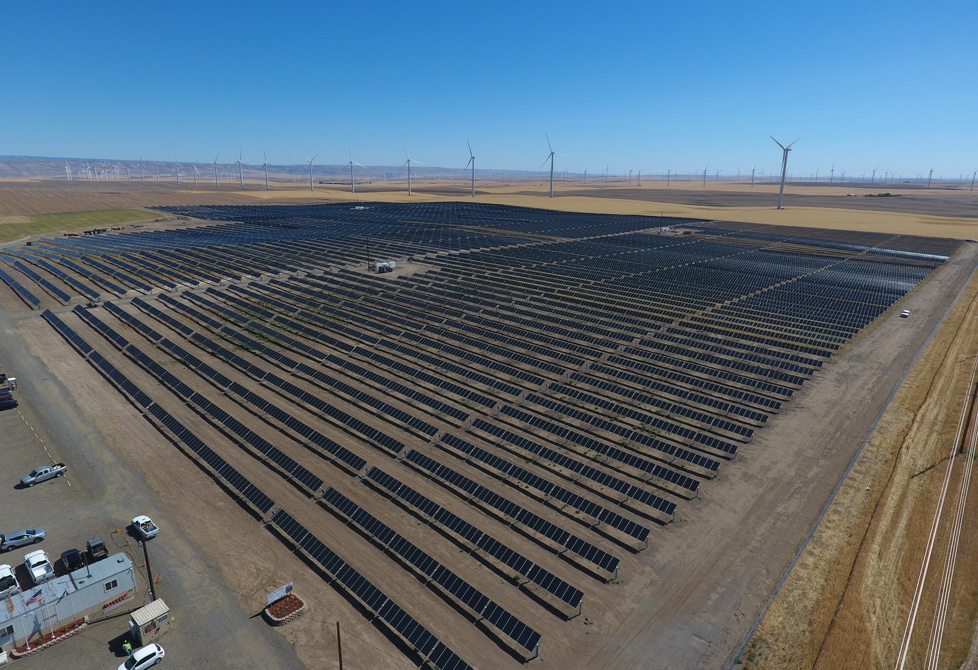
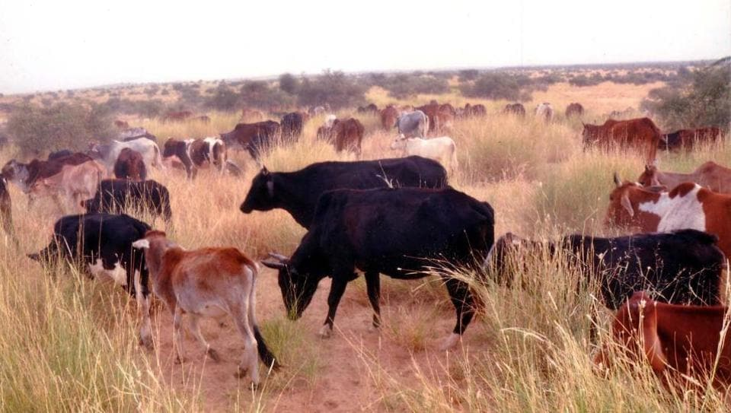
Problem
Biocrusts make up ~12% of Earth's surface, but climate fluctuations and land use have led to biocrust degradation
Ecological rehabilitation goal: the production of biocrusts to rehabilitate degraded ecosystems
For most biocrust species, there is little to no literature on potential for cultivation
(Bowker, M., Antoninka, A., Durham, R., 2017)
Photo Credit: KUOW
Photo Credit: Hindustan

Slide 5
Objective
Research Question: How can we cultivate biocrusts in order to reintroduce them to degraded ecosystems?
  Establishing a cultivation method using a fog chamber will create and optimize a way to grow biocrust materials to use for restoration purposes
  Different species will have different growth/decay in the fog chamber because of their different water needs and physiology

Slide 6
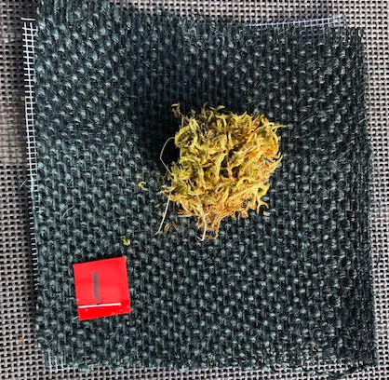
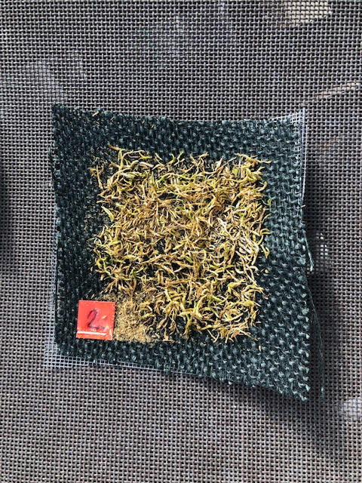
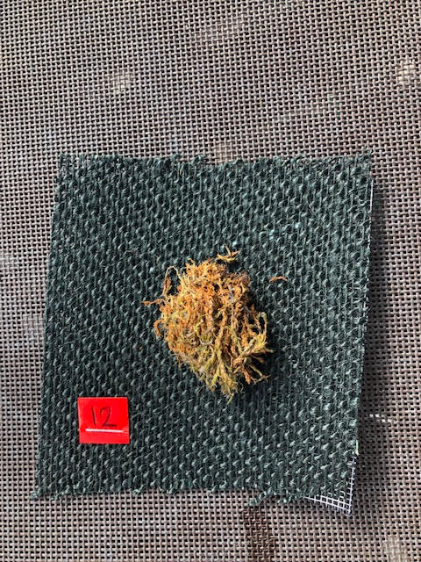
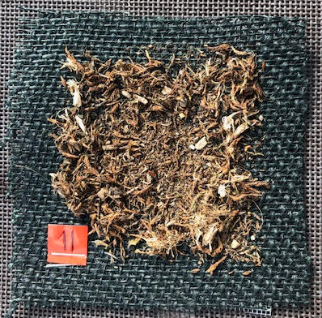
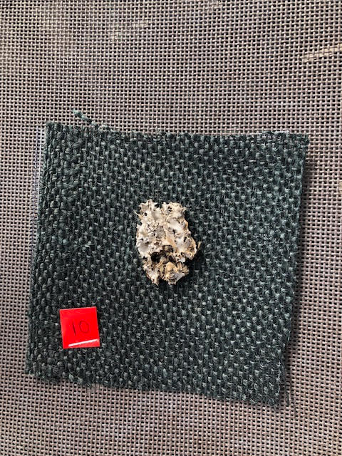
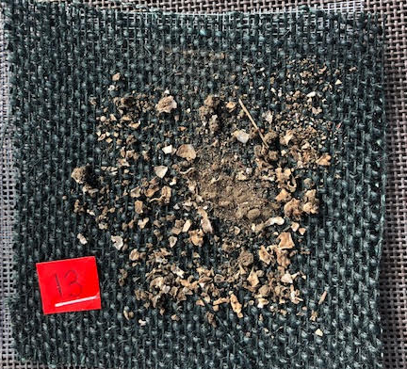
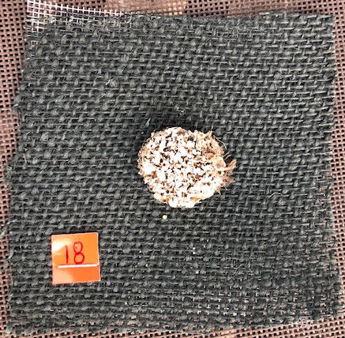
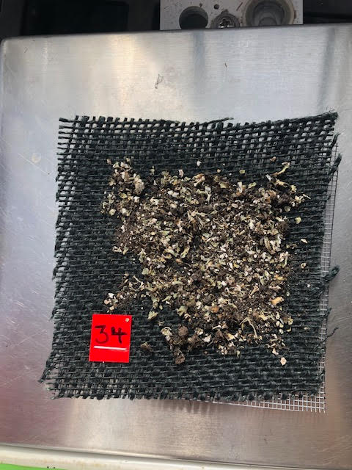
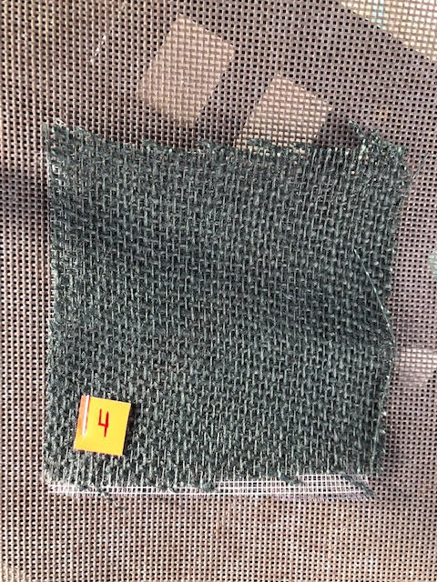
Methods and Activities
A
B
4 species: A)Homalothecium B)Syntrichia C)Peltigera D)Cladonia
2 sizes: entire (2-3cm cores) and sieved
5 whole and 5 sieved for each
E)5 controls
Put on burlap
C
D
E

Slide 7
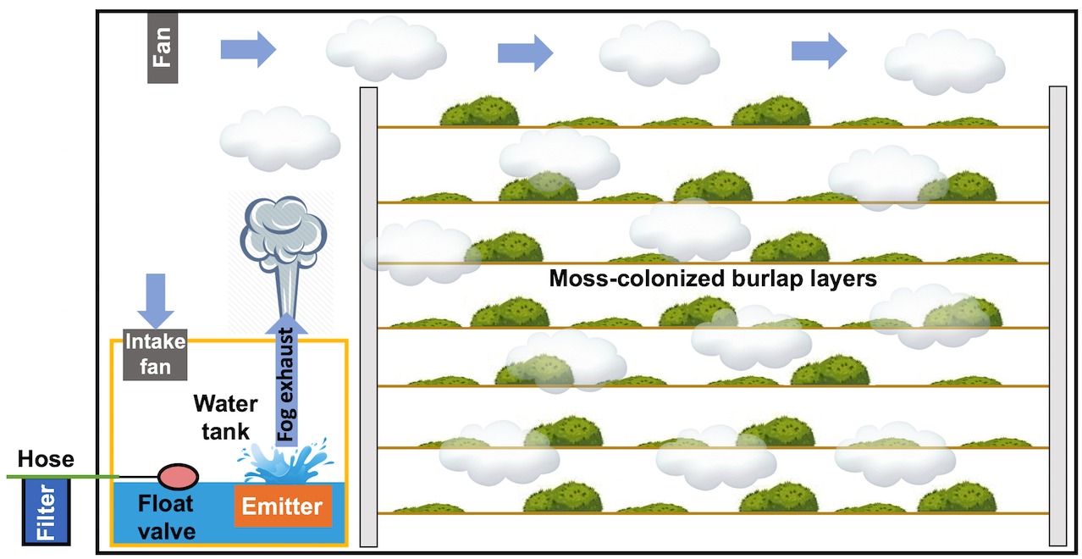
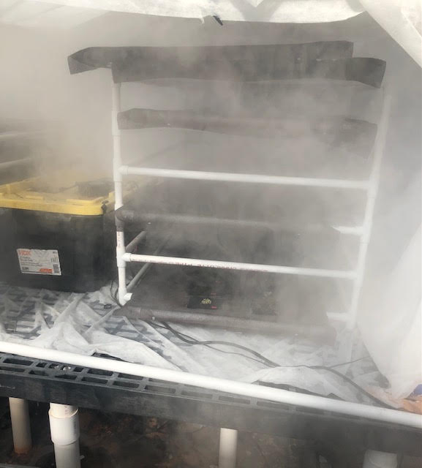
The Fog Chamber
Photo Credit: Bowker Lab
Converts water to mist using ultrasonic vibrations

Slide 8
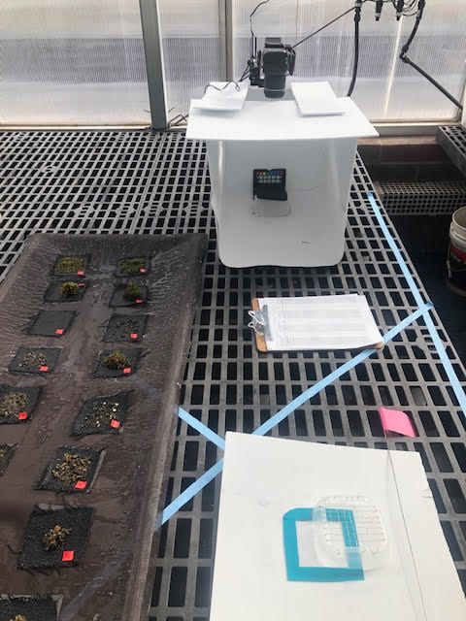
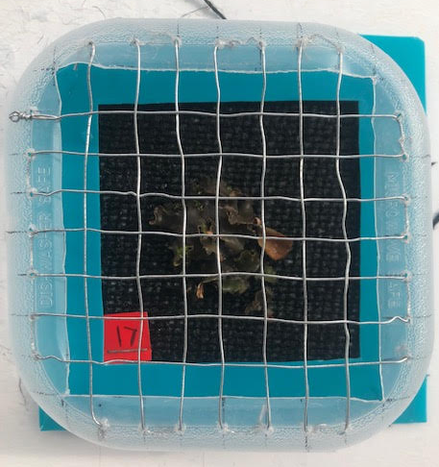
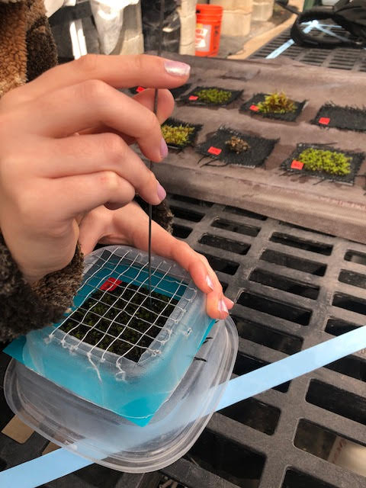
Sampling Technique
49-point intercept cover
6 Categories:
Bare (burlap)
Healthy Tissue
Dead Tissue
Litter
Other
Number of Germinants
Put into a light box for pictures

Slide 9
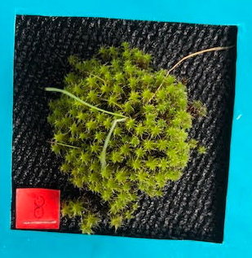
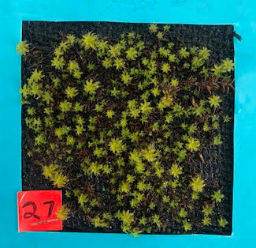
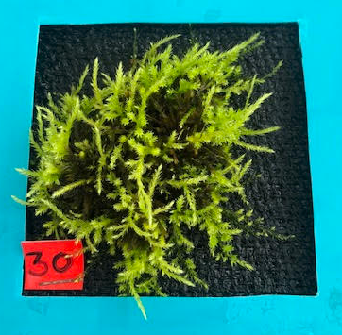
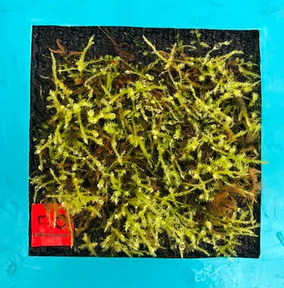
Results
Week 1
Week 11
Syntrichia
Homolathecium

Slide 10
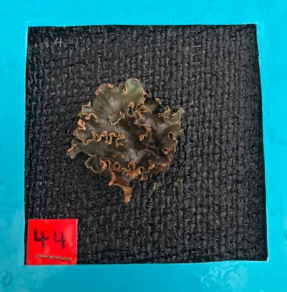
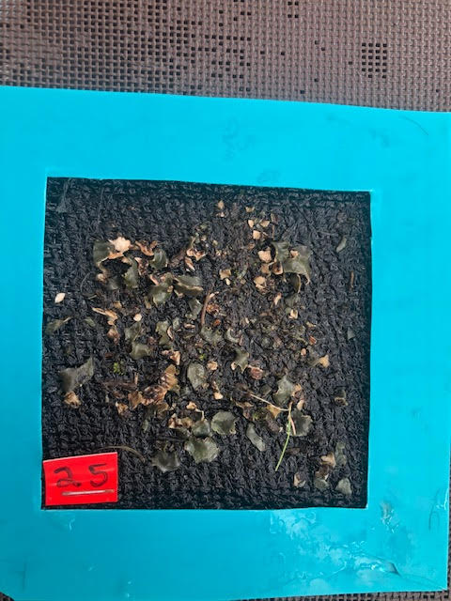
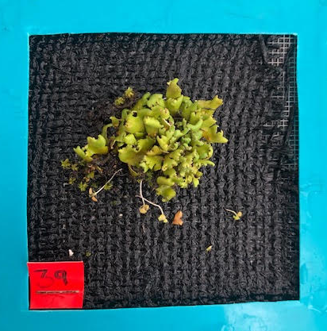
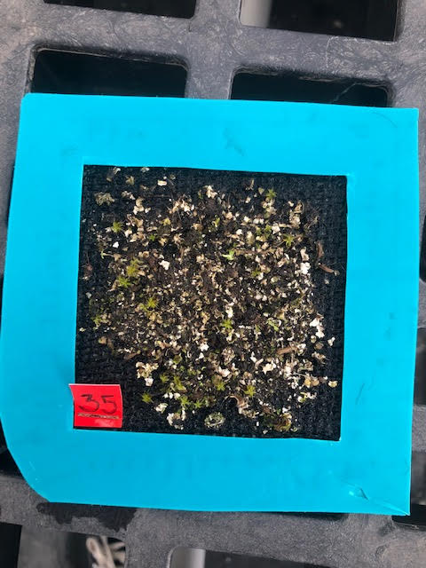
Week 1
Week 11
Peltigera
Cladonia

Slide 11
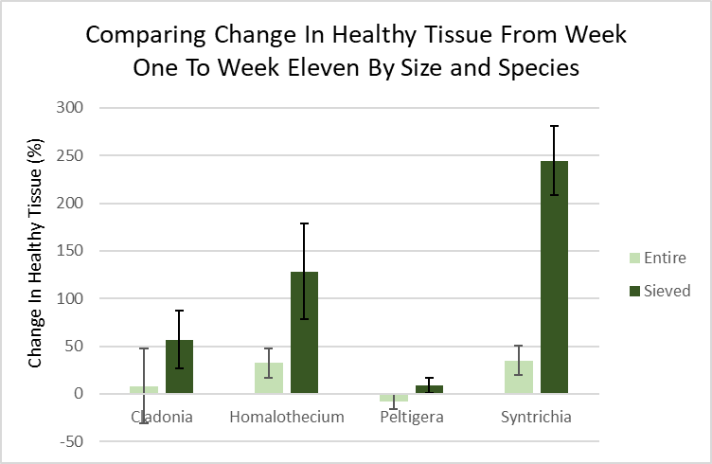
1) Comparing overall healthy tissue at the end across all samples
A
A B
B C
2) Comparing change in sieved treatment vs. entire treatment for each species from beginning to end
C

Slide 12
Interpretation
Sieved increased the most in healthy tissue cover when compared to entire samples
Mosses (Homolathecium and Syntrichia) increased the most in healthy tissue cover compared to the lichens (Cladonia and Peltigera)
Positive growth in all treatments over time except Peltigera entire

Slide 13
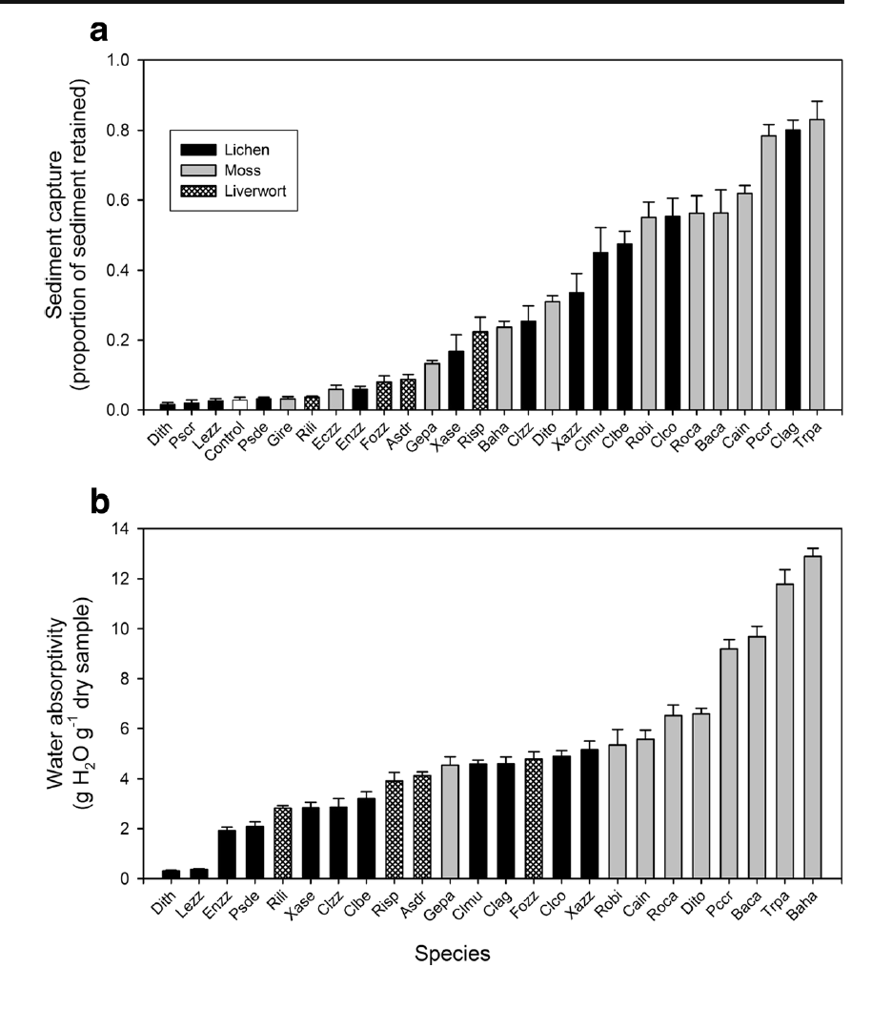
Trait Measurements
(Mallen-Cooper and Eldridge 2016)

Slide 14
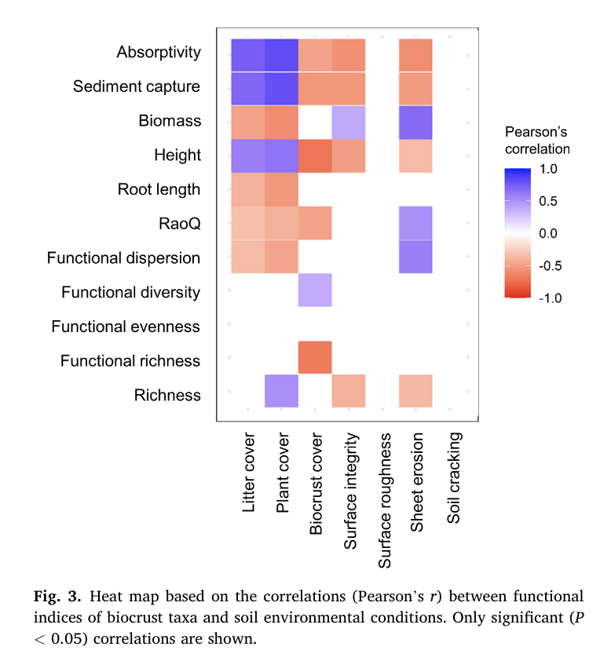
Trait Measurements
(Mallen-Cooper and Eldridge 2016)
(Eldridge et al. 2021)

Slide 15
Significance
Further development of biocrust cultivation and trait measurements will allow biocrust to be efficiently reintroduced into degraded ecosystems
Important as global climate change and land degradation is exacerbated in the future

Slide 16
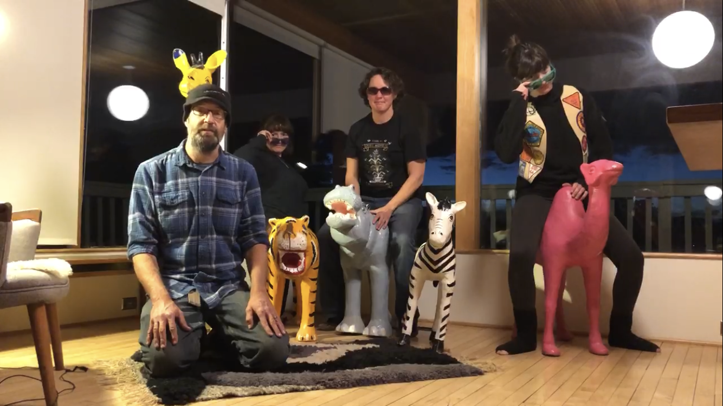
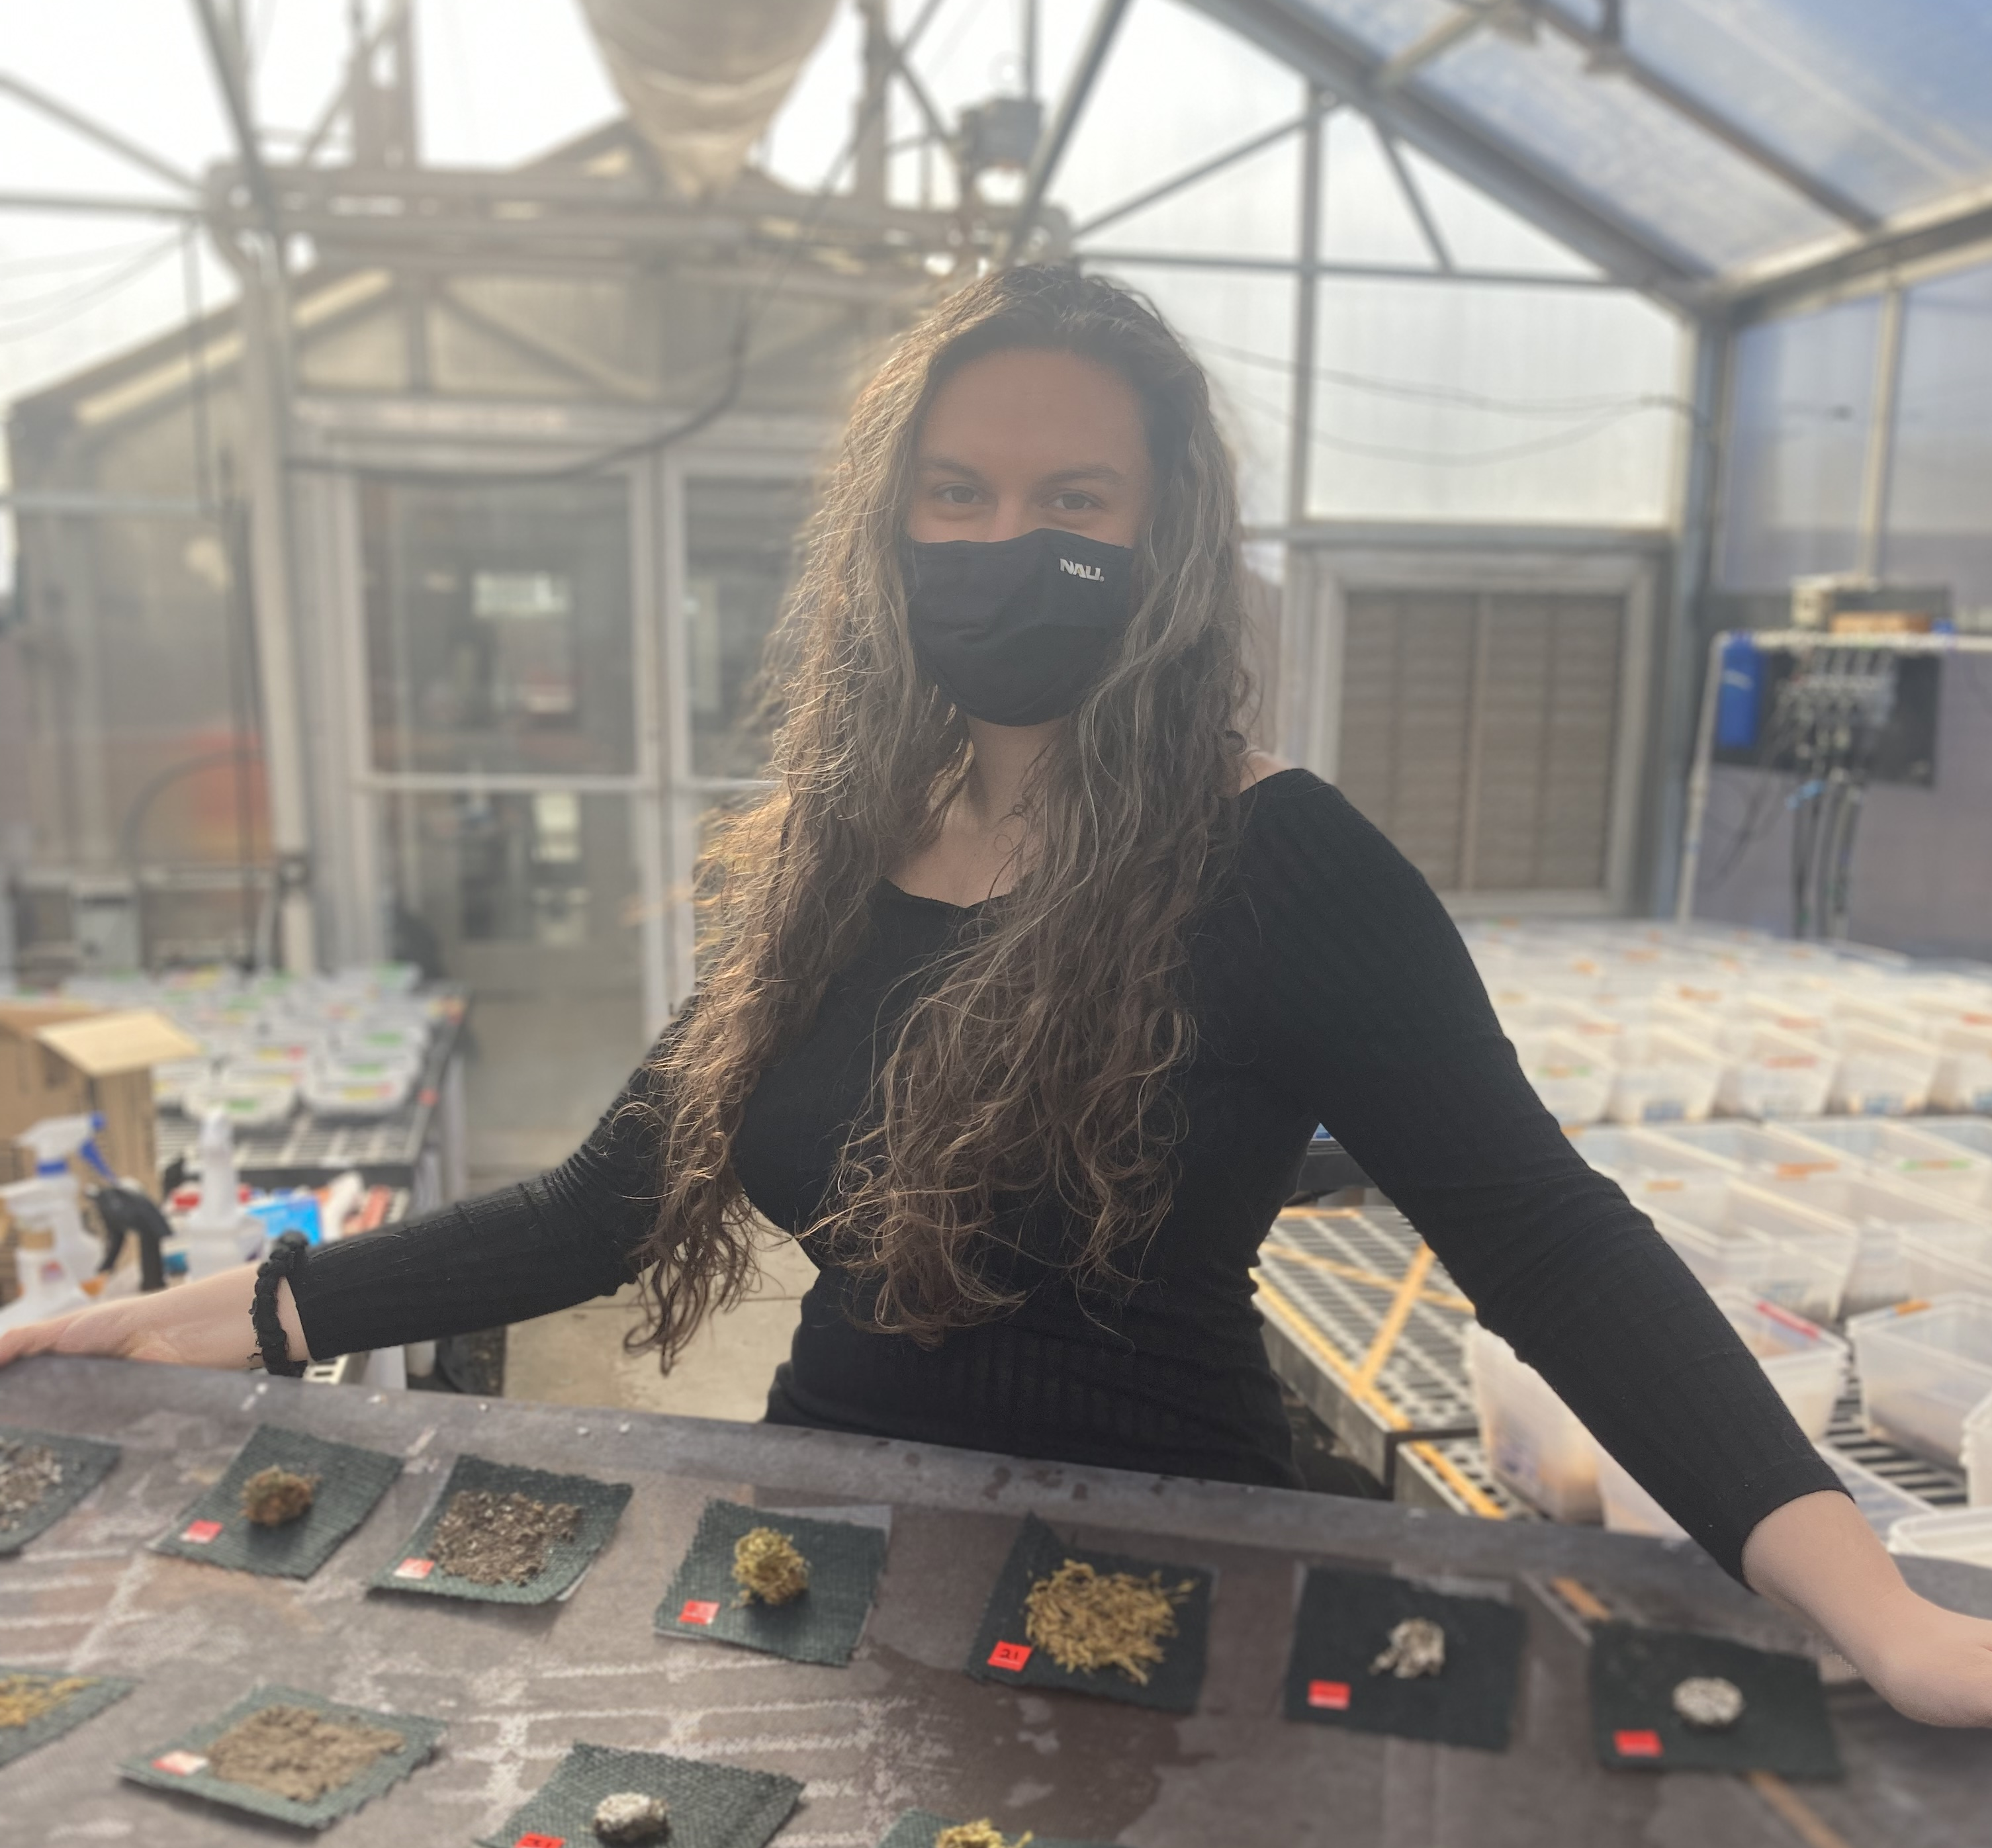
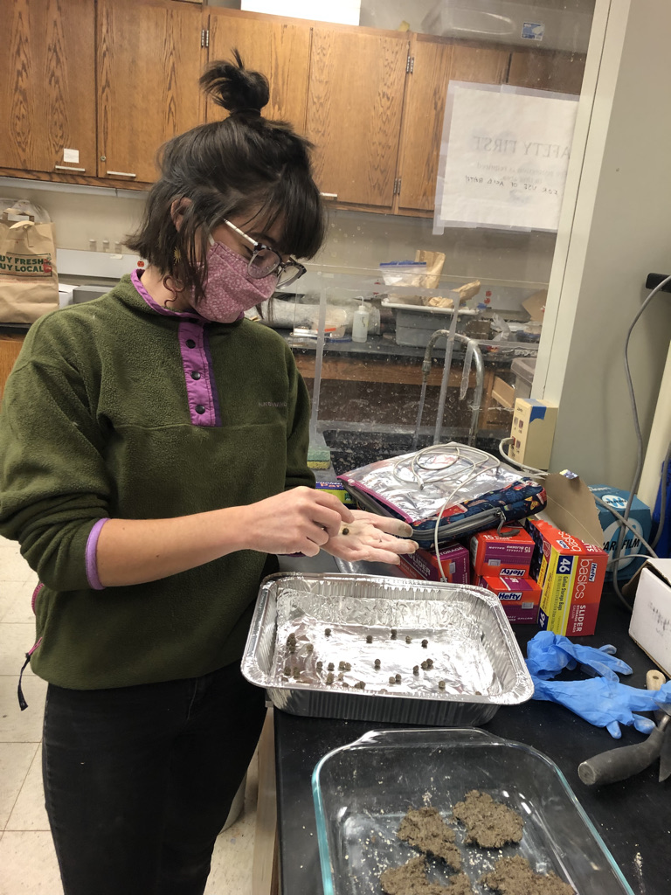
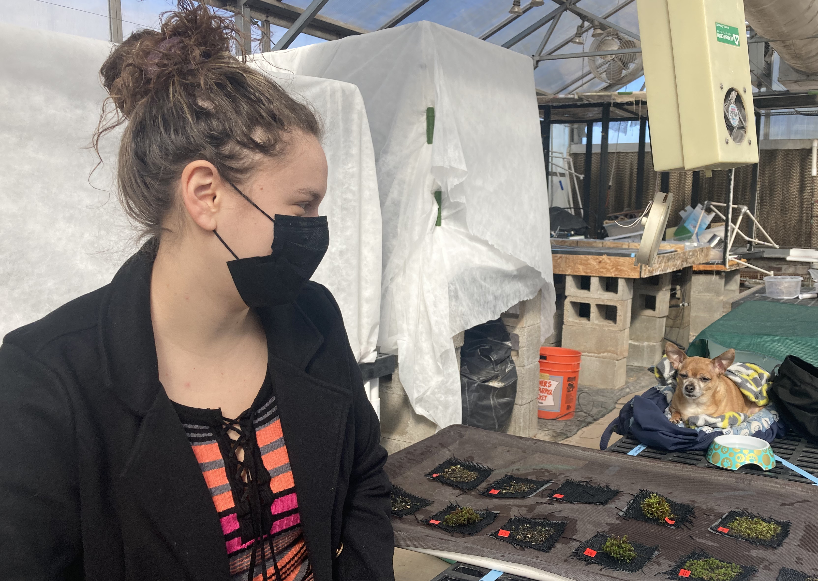
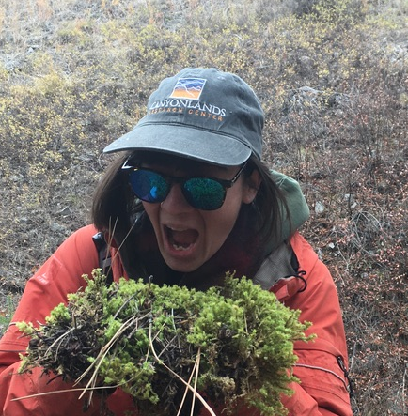
Acknowledgements
Thank you to my mentor Jasmine Anenberg, as well as Dr. Anita Antoninka, Dr. Matthew Bowker and the NAU Forest Rangeland Soil Ecology Lab, Claire Johnson, MPG Ranch, and the NASA Space Grant Consortium for assisting and for funding this research project
Photo Credits: Bowker Lab

Slide 17
Thank You!

